Slide 1
How Qualitative Beats Quantitative! Better Risk Management with Kanban
TNG Tech Days
Munich
June 2012
David J. Anderson
David J. Anderson & Associates, Inc. dja@djaa.com
Twitter @agilemanager

Slide 2
Let’s consider a story of quantitative assessment

Slide 3
Dan Ariely Behavioral Economist (age 30 at the time)
Time to grow up and buy a car
Lifetime of riding a motor cycle has to end
Time to drive a girlfriend around
Think about marriage – maybe kids

Slide 4
Used a web site to make a quantitative assessment to determine the ideal car!
Preferred Safety Rating …. 1 to 5
Preferred Braking Distance (from 50km/h) < 30m, 30m - 60m, >60m
Ideal turning radius …. < 3,5m, 3,5m – 4,0m, 4,0m – 4,5m, > 4,5m
Price Range
$10,000 - $14,999
$15,000 - $19,999
$20-000 - $29,999
$30,000 - $39,999
$40,000 - $49,999
> $50,000
And so on…

Slide 5
It’s a Ford Taurus!

Slide 6
How do you feel?

Slide 7
So what to do?
Press the BACK button
Change the answers
Try again!
Iterate on this process until the right answer appears after several tries
And so…

Slide 8
It’s a Mazda MX-5

Slide 9
And how do you feel now?

Slide 10
How do we typically build a business case?

Slide 11
Let’s consider a fictitious web development example…
Imagine an ad revenue model
New features/pages drive traffic that provides revenue via ad impressions
Our governance model says new features should be prioritized by Return on Investment
ROI = Ad Impressions / Cost
Let’s make spreadsheet to show our business case!

Slide 12
Initial forecast for a single feature

Slide 13
But wait…
Can we be certain about those numbers?
How confident are we?
What range of possibilities exist?
To consider this let’s look at a distribution curve example (admittedly from a different activity)

Slide 14
2nd confidence interval 98th %-ile
1st confidence interval 15th -ile
Mean of 31 days
1st confidence interval 85th %-ile
Distribution of lead time to complete features (in calendar days)

Slide 15
Quantitative Assessment of Historical Data shows…
There is a 70% probability that new features will take between 5 days and 45 days to complete with a mean of 31 days
We could make a similar assessment of historical ad impressions and use this to provide low, medium and high estimates
Let’s update our spreadsheet to show this additional detail

Slide 16
New estimates showing range of possibilities

Slide 17
Let’s add some more features and make similar estimates

Slide 18
Now we need some cost estimates (from our web development team)
How long will this feature take to develop?
Industry data shows typical spread of 2x above and below the mean estimate

Slide 19
And together these figures allow us to calculate a range of ROI for each feature
Shows worst case to best case with mean
Now stack rank highest to lowest!!!

Slide 20
Oh dear! Stack ranking isn’t so easy!

Slide 21
So what to do now?
Perhaps we can find some ways to be more precise and narrow down the spread of variation?
Let’s add some more details to our spreadsheet! These will indicate our confidence in our numbers and allow us to narrow our range! [Honestly, we do believe this!!!]

Slide 22
Questions to be answered…
How well known is the celebrity, sport, team or business? 1 thru 5
How controversial/salacious is the content? 1 thru 5
How “hot” are the pictures? 1 thru 5
1 = not very 3 = reasonably 5 = very

Slide 23
Updating our Spreadsheet we see…

Slide 24
We can sort the answers
Our questions were used in a formula to indicate a specific confidence within the range and derive a “precise” value for ROI
Is this the result we like? Does it feel right?
If not keep iterating or adding detail…

Slide 25
Maybe we need more precision?
Let’s do the same for the cost side of the equation…
Needs Flash? – yes|no
Needs Javascript? – yes|no
How challenging is the programming? 1..5
Custom artwork? – yes|no
New template? – yes|no
Now make a formula to make sense of all this and update the spreadsheet again

Slide 26
If you still have the energy…
This quantitative product management stuff is hard work!
Product Managers should be paid a lot! ;-)

Slide 27
Let’s try an experiment!

Slide 28
How long will it take to assess the level of Kanban knowledge in this audience?

Slide 29
Who thinks it can be done with sufficient accuracy and detail to be useful and completed within 5 minutes?

Slide 30
Kanban Knowledge Self-Assessment
0. No Knowledge
1. Below Novice – heard the name
2. Novice – watched videos, or read articles or attended a conference
3. Practicing – one small team, small workflow, < 6 months
4. Experienced Practitioner – deeper implementation, longer workflow, several departments, > 6 months
5. Master – large scale implementation, business unit wide, 10+ kanban systems, > 18 months
+1 if you have read the Kanban book

Slide 31
What is a Kanban System? & Which risks are we managing?

Slide 32
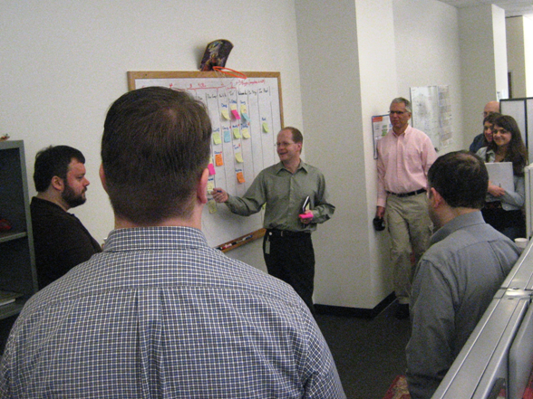
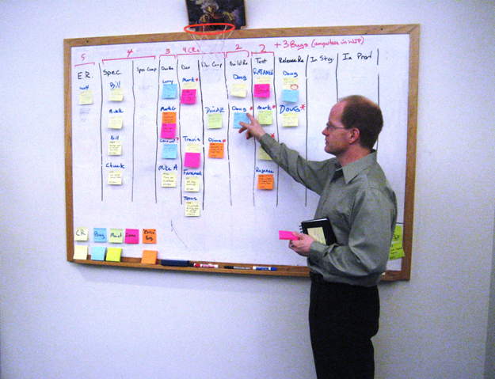
A Kanban System models a workflow and limits WIP at each step, signaling available capacity, effectively creating a pull system for work orders
White boards were introduced in 2007 to visualize workflow, signal capacity and show work orders flowing through the system

Slide 33
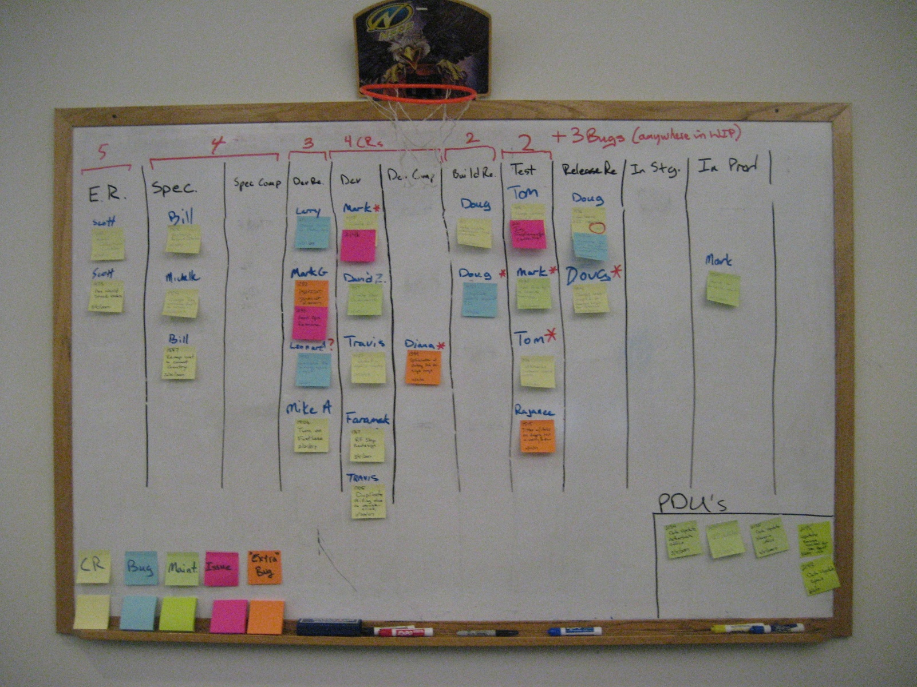
Boards typically visualize a workflow as columns (input) left to (output) right
WIP Limit – regulates work at each stage in the process
Pull
Flow – from Engineering Ready to Release Ready

Slide 34
Tickets on the board are “committed” Backlog items remain “options” Kanban systems defer commitment & enable dynamic prioritize when a “pull” is signaled
5
4
3
4
2
2
Input Queue
Analysis
Dev Ready
Development
Build Ready
Test
Release Ready
Stage
Prod.
In Prog
Done
In Prog
Done
Flow
Commitment point

Slide 35
Kanban Systems encourage scheduling & dynamic prioritization by “(opportunity) cost of delay”

Slide 36
How do we calculate “Cost of Delay?”

Slide 37
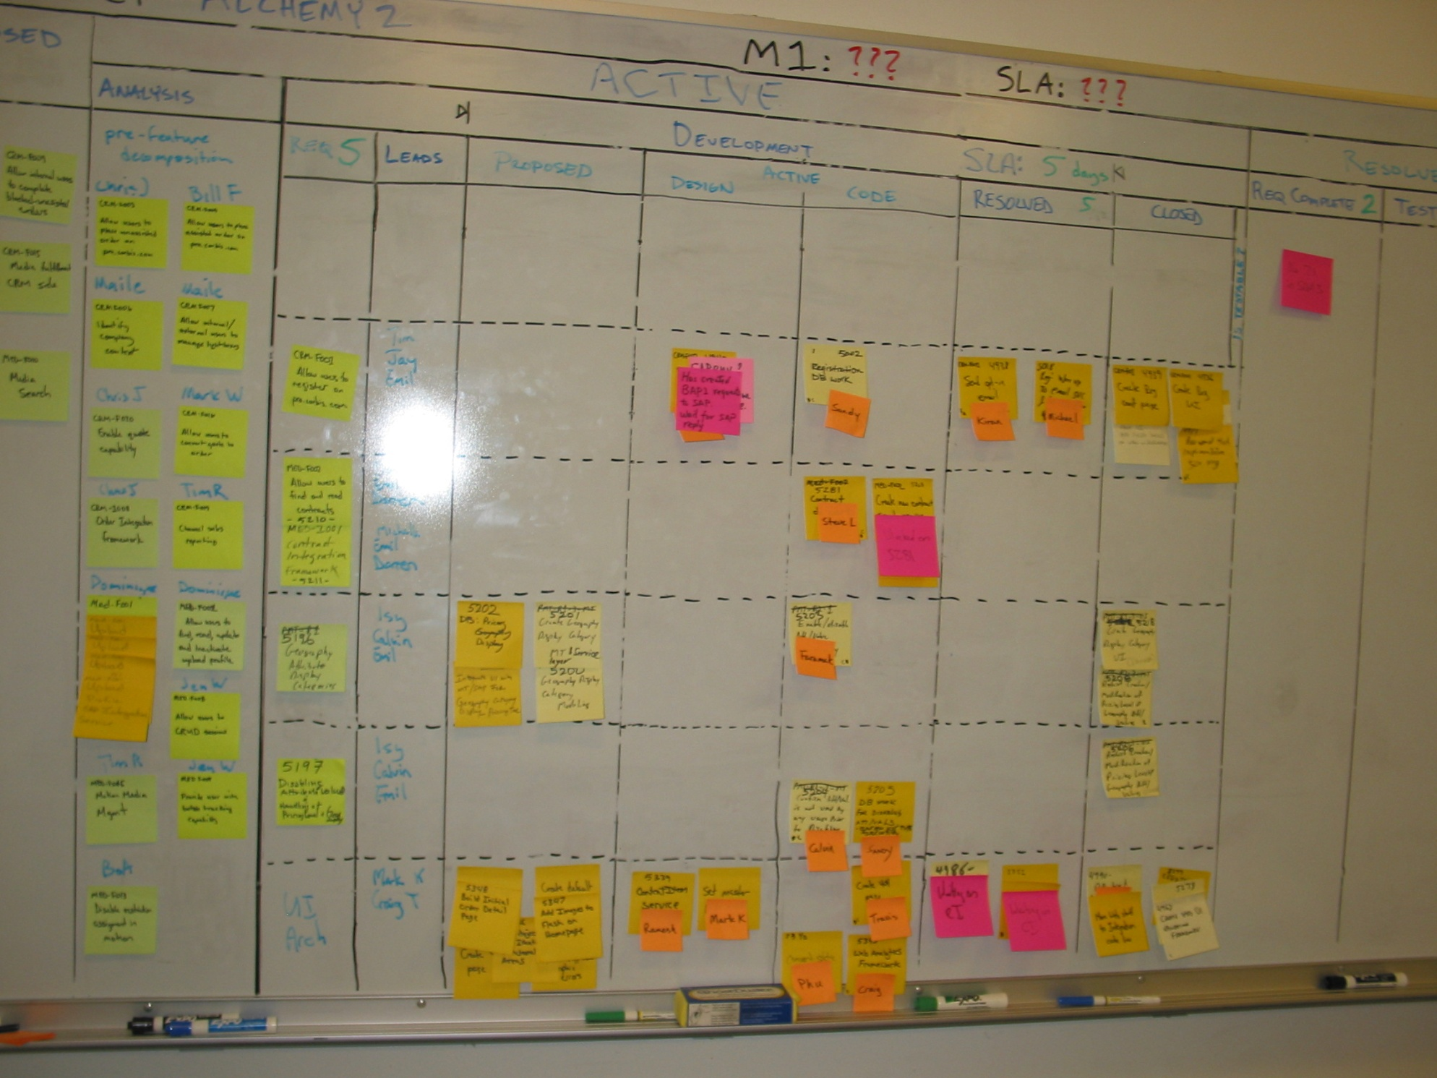
Large ERP project in 2007. Predicted delay of 4 months. Ask CFO, “What was the cost of delay?”

Slide 38
Quantitative Assessment
A finance analyst took almost 1 month to calculate the “cost of delay”
Involved “burn rate” component for overrun of project + lost opportunity from cost savings after deployment
Estimate was $1.5/month
Quantitative assessment was possible because this was a cost saving project and the cost savings and burn rate were known and could be accurately assessed
Still the assessment took several weeks to compile

Slide 39
Potential Dysfunction
If the project hadn’t been a cost saving project but a revenue generating project then the assessment of lost opportunity would have been challenging
Where there is speculation, uncertainty and lack of confidence in the data, there is often delay. Delay in calculating the cost of delay would likely increase the overrun on the project, amplifying the cost of delay

Slide 40
Hard Questions
Asking for quantitative assessment is asking a "hard question." It seeks precision and precision and confidence in the answer is hard (or impossible) to achieve.
When you ask someone a hard question but a question they should be able to answer from a professional perspective, you may get a dysfunctional response, a delayed response or no response at all. Why?

Slide 41
What causes a dysfunctional response?
When quantitative numbers with a spread of uncertainty are available, opinions as to the actual outcome are likely to be as varied as the number of people asked.
Forming a consensus is hard or may be impossible!
Lack of confidence and uncertainty in quantitative estimates leads to dysfunctional behavior, causes delay due to personal political risk, professional embarrassment, and failure to form consensus.

Slide 42
Let’s consider a qualitative alternative

Slide 43
Cost of delay function sketches provide a qualitative taxonomy to delineate classes of risk
Colour
Function
 |  | Expedite – white; critical and immediate cost of delay; can exceed other kanban limit (bumps other work); 1st priority - limit 1
 |  | Fixed date – orange; cost of delay goes up significantly after deadline; Start early enough & dynamically prioritize to insure on-time delivery
 |  | Standard - yellow; cost of delay is shallow but accelerates before leveling out; provide a reasonable lead-time expectation
 |  | Intangible – blue; cost of delay is not incurred until significantly later; important but lowest priority
impact
time
impact
time
impact
time
impact
time

Slide 44
Allocate capacity across classes of service mapped against demand
5
4
3
4
2
= 20 total
2
Input Queue
Analysis
Dev Ready
Development
Build Ready
Release Ready
In Prog
Done
In Prog
Done
Test
Allocation
+1 = +5%
4 = 20%
10 = 50%
6 = 30%

Slide 45
A 2nd dimension to qualitative cost of delay
If all work orders are not of the same order of magnitude in value or opportunity, we may need more info
Impact Order of Magnitude Classification
Extinction Level Event
Major Capital
Discretionary Spending
Intangible

Slide 46
More examples of qualitative assessment classifications

Slide 47
Market Risk of Change Classification
Highly likely to change
Misdirector – differentiator not aligned with strategic plan
This is not a prioritization scheme!
But a way of understanding schedule & value risk
Differentiator
Spoiler
Market Risk
Value
Cost Saver
Regulatory – must have but subject to change
Table Stakes
Very unlikely to change

Slide 48
Kanban board with capacity allocated by market risk of change Useful for big projects with the risk of demand for early delivery
5
4
3
4
2
= 20 total
2
Allocation
Total = 20
Input Queue
Analysis
Dev. ready
Development
Build ready
In Prog
Done
In Prog
Done
Test
Table Stakes
10
Cost Reducer
2
Spoiler
2
Differentiator
6

Slide 49
Product Lifecycle Classification
Not well understood
High demand for innovation & experimentation
High
Innovative/New
Small
Growth Market
Profit Margin
Market Risk
Large
Requires Investment
Existing Product Evolution – satisfies demand from existing customer base
Cash Cow
Small
Well understood Low demand for innovation
Very Low

Slide 50
Project Portfolio Kanban Board Implementation
Horizational position shows percentage complete
Allocation of personnel
Total = 100%
Projects-in-progress
Cash Cows
10%
Project B 5%
Project A 5%
Growth Markets 60%
Project C 40%
Project D 20%
Innovative/New 30%
Project E 10%
Project K 5%
Project G 5%
Project F 5%
Project H 5%

Slide 51
Extracting a generic approach from these examples

Slide 52
A middle-ground in effective risk management
Qualitative Taxonomies
2 -> 6 categories
Cheap
Fast
Accurate
Consensus
Managed Risk
Homogenous
Cheap
Fast
High Risk
Heterogeneous
Expensive
Time Consuming
Fake Precision?
May still be
High Risk

Slide 53
Kiveat Diagrams Visualize Multiple Dimensions of Risk
Start Early
Market Risk
TS
CR
Tech Risk
Lifecycle
Spoil
Unknown Soln
Known but not us
Diff
New
Done it before
Mid
Commodity
Start Late
Cow
Intangible
Profile of 2007 ERP Project
(shown earlier)
Disc
Std
Maj. Cap.
FD
Delay Impact
ELE
Expedite
Cost of Delay

Slide 54
Conclusions

Slide 55
Quantitative Assessment
Implies the pursuit of precision
Typically has uncertainty and wide confidence intervals
Works well with observable capabilities such as lead time through system
Doesn’t work well where opinion (guessing) is required
Can be expensive and time consuming to gather
Challenges using quantitative data tend to lead to vicious spiral of demand for greater and greater precision
Complex formula involved, often mask real risks or obfuscate information
Often produces results that people intuitively know to be wrong

Slide 56
Qualitative Assessment
Often fast to obtain
Easy to obtain
Facilitates achievement of consensus
Can be designed into Kanban Systems using capacity allocation, queue replenishment selection criteria & classes of service
Visualization can show risks under management in an immediate manner
Facilitates effective, affordable risk management without excessive waste

Slide 57
Results
Better alignment with corporate strategy
Provides transparency onto risks under management
Good governance is facilitated by designing risk management strategy into the kanban system design

Slide 58
Qualitative beats Quantitative!

Slide 59
Faster, Better, Cheaper Risk Management!

Slide 60
Thank you!
dja@djaa.com
http://djaa.com/

Slide 61
New Book Published June 2012
115,000 words of anecdotes explaining my approach to leadership, management & change

Slide 62
German published January, 2011
Translation by Arne Roock & Henning Wolf of IT-Agile

Slide 63
Published in May 2010
A 72,000 word intro to the topic

Slide 64
About…
David Anderson is a thought leader in managing effective software teams. He leads a consulting, training and publishing and event planning business dedicated to developing, promoting and implementing sustainable evolutionary approaches for management of knowledge workers.
He has 30 years experience in the high technology industry starting with computer games in the early 1980’s. He has led software teams delivering superior productivity and quality using innovative agile methods at large companies such as Sprint and Motorola.
David is the pioneer of the Kanban Method an agile and evolutionary approach to change. His latest book is published in June 2012, Lessons in Agile Management – On the Road to Kanban.
David is a founder of the Lean Kanban University, a business dedicated to assuring quality of training in Lean and Kanban for knowledge workers throughout the world.
http://leankanbanuniversity.com Email: dja@djaa.com Twitter: agilemanager

