Slide 1
Risk Management Is Project Management For Grown-ups
Presented by Tim Lister

Slide 2
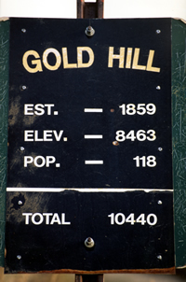
For David Anderson…

Slide 3
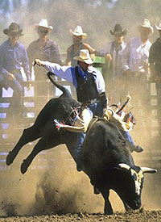
This is a risk…

Slide 4
This is a risk… This is a problem.

Slide 5
NO!

Slide 6
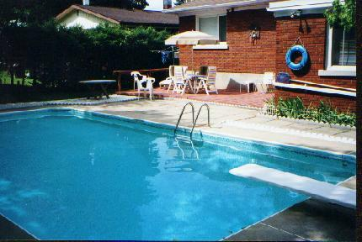
What Does it Cost
to Build a Swimming Pool?

Slide 7
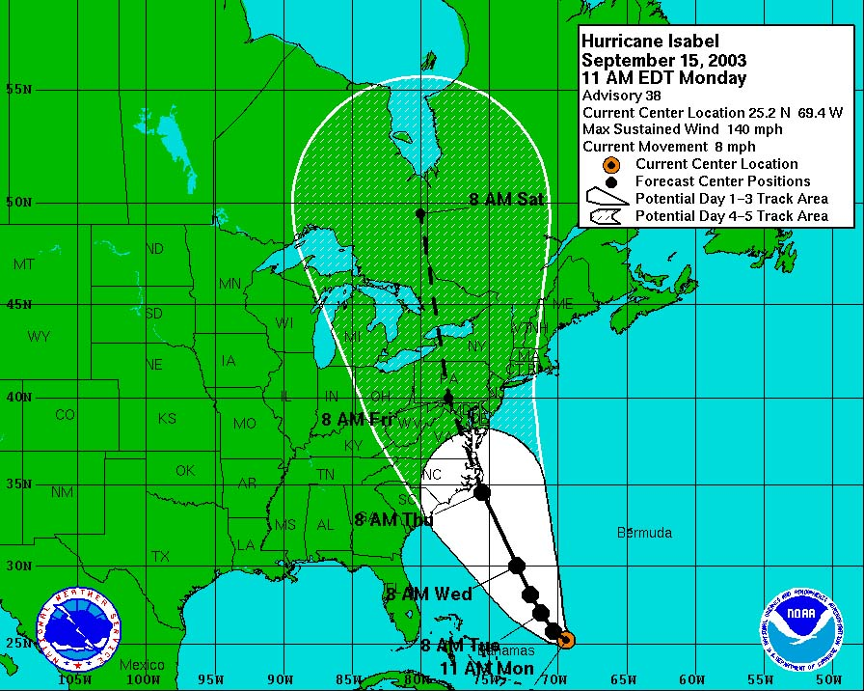
2 Ways to Think About Risk…
A risk is a potential problem.

Slide 8
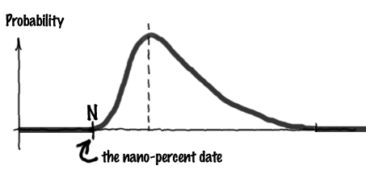
2 Ways to Think About Risk…
A risk is any variable on your project that,
within its normal distribution of possible values, could take on a value that is detrimental, even fatal, to your project.

Slide 9
We Can’t Avoid Risk...
All projects with benefit but no risk were completed long ago.
You can’t control many of the variables that could be risks.
Version 8.0
Will be ready
when you
need it!

Slide 10
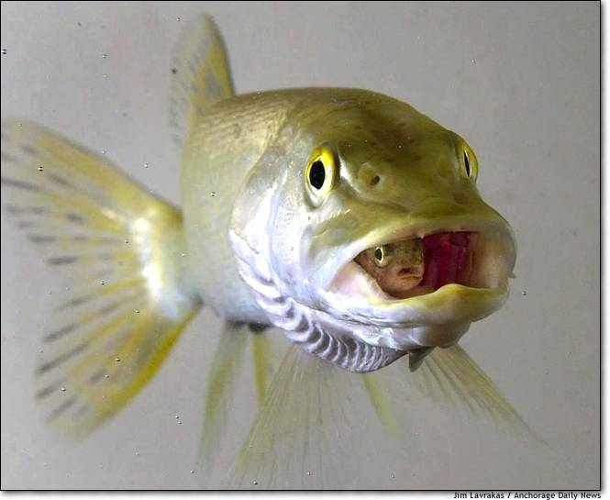
Avoiding a risk usually lowers
the value of the product.
(Value inside a Risk.)

Slide 11
A Risk Ritual...
Identify risks
Assess risk exposure
Determine which risks to manage
Form action plans for direct risks.
Form mitigation plans for indirect risks.
Determine contingency fund.
Build tripwires into project plan.
Keep the process going...

Slide 12
Identify Risks
Don’t start with a blank sheet -- www.sei.cmu.edu then “software risk management”
McConnell’s Rapid Development
Sweep for risks using brainstorms
Keep tribes separate

Slide 13
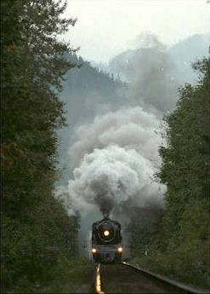
Assess Risk Exposure
Determine probability of risk becoming problem.
Determine cost/effort if it does become a problem.
Oh, that
on-coming
train!

Slide 14
Determine Which Risks to Manage
Is there a profitable trade-off here?
Are there any actions I can take now that will either lower the probability or the cost?
Should I try to contain this risk by building some contingency into my plan?
abulia, also aboulia \uh-BOO-lee-uh; uh-BYOO-\, noun:
Loss or impairment of the ability to act or to make decisions.

Slide 15
Form Action Plans for Direct Risks
Some risks you can mitigate immediately.
This mitigation will cause you to change project plan, product definition, staffing plan…something!

Slide 16
Form Mitigation Plans for Indirect Risks
Some risks you can’t mitigate now.
Determine actions if the problem manifests.
Determine tripwire for risk-problem transition.
Build in contingency.

Slide 17
Indirect Risk Mitigation… Risk 3: All functionality may not be ready to go at start of new fiscal year. Mitigation: Build “bridge code’ between old system and new, using sub-systems 3 and 4 of old until all is ready. Probability: 50% Tripwire: If all DDRs are not passed by 12/21/1999, we build bridge. Cost: Al + 2 contractors = 6 work months = $170,000.

Slide 18
Keep the Process Going
No reason to believe that you can identify all risks in one go.
Review risks for changes in likelihood and opportunities for new actions.
Retire a risk; they all move up the list.

Slide 19
Good Luck on your project…

Slide 20
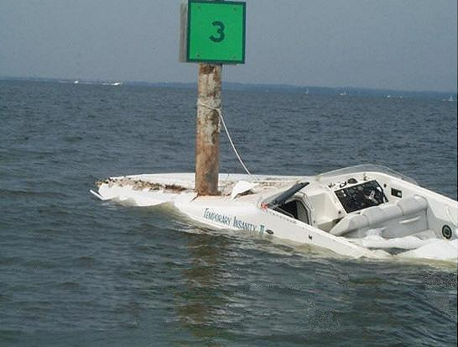
Good Luck on your project…
Just don’t count on it!

Slide 21
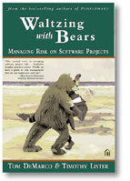
Tim Lister
The Atlantic Systems Guild, Inc.
3143 Broadway, 2B
New York NY 10027 USA
212 620-4282
lister@acm.org
systemsguild.com

