Slide 1
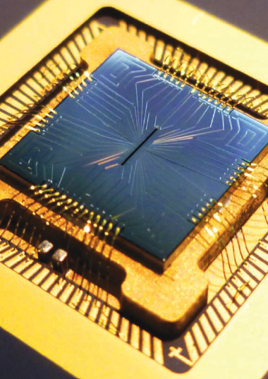
Quantum Computers: Fundamentals, Applications and Implementation
ˆ
z = |0 >
|ψ >
θ
ˆ
y
φ
ˆ
x
ˆ
-z = |1 >
Ben Feldman, Harvard University
Big Techday Conference
June 14, 2013
Image: Introduction to quantum information processing review, Science 339, 1163 (2013).

Slide 2
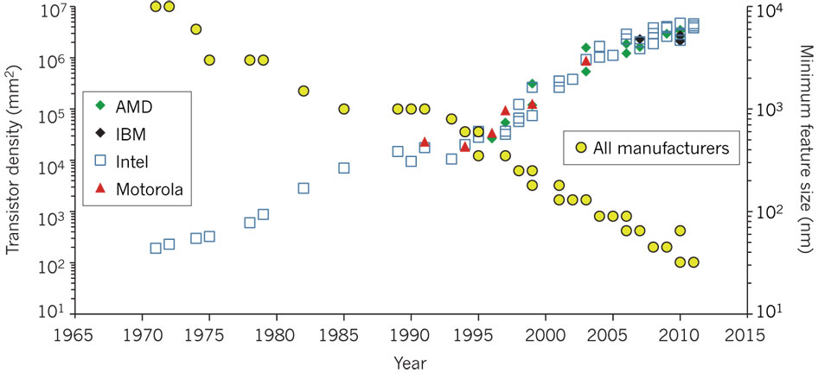
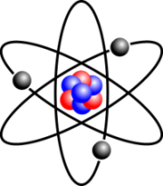
Motivation: Future of Computers
Moore’s law
…will soon run into major physical constraints
2020
2030
2040
2050
1 nm
Gate
Insulator
Silicon
Source
Drain
0.1 nm
(atomic radius)
?
Moore, G. E. Electronics 8, 114–117 (1965).
Image from: Ferain, I. et al., Nature 479, 310–316 (2011).

Slide 3
Limitations of Classical Computers
RSA encryption (2048-bit)
100,000 computers in parallel
3 GHz processors
Factoring would take longer than the age of the universe
Quantum Simulation: inefficient with classical computers
Feynman: why not use quantum mechanics for computation?

Slide 4
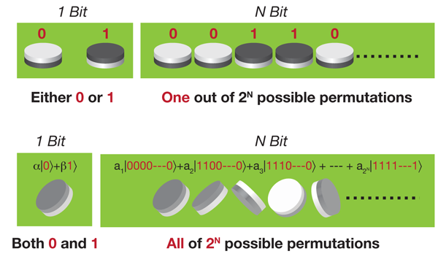
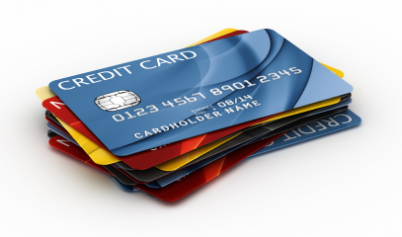
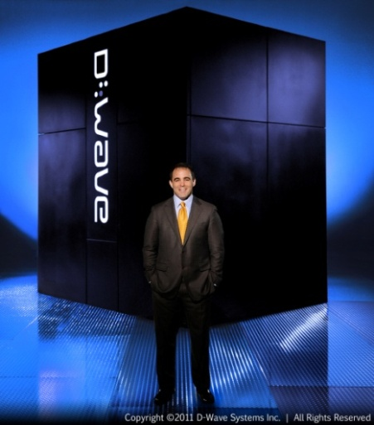
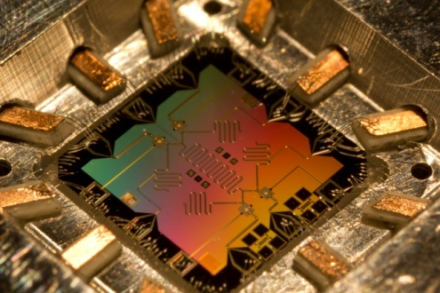
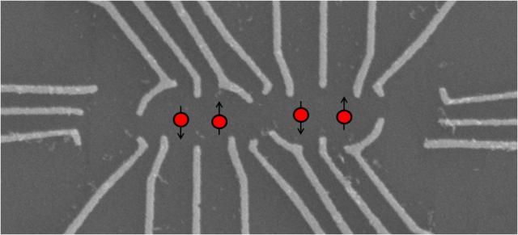
Outline
What are quantum computers?
Classical vs. quantum bits
Problems suited to quantum computation
How to realize a quantum computer

Slide 5
Outline
What are quantum computers?
Classical vs. quantum bits
Problems suited to quantum computation
How to realize a quantum computer

Slide 6
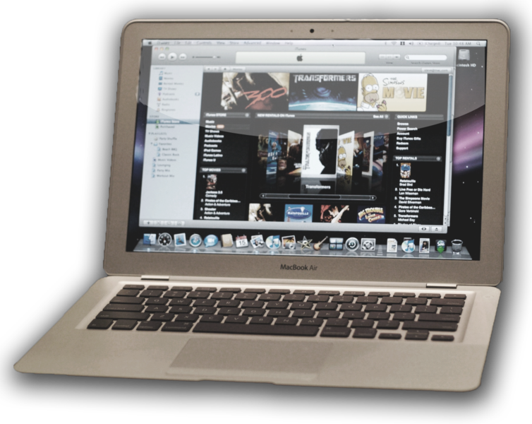
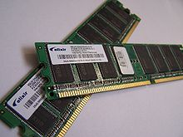
Standard Computers
Classical bits + Logic and Memory = Computer
0
+ =
1

Slide 7
Quantum Bits (qubits)
Classical Bits
Qubits
Can be only 0 or 1
OR
Superposition of both 0 and 1
AND
Any quantum two-level system can act as a qubit, e.g.
Atoms
Spins
Notes:
300 qubits = 1 bit per atom in the universe

Slide 8
Quantum Bits (Qubits)
ˆ
z = |0 >
Quantum Bit:
|ψ > = cos(θ/2)|0> + e^{iφ}sin(θ/2)|1>
= a|0> + b|1>
Any vector pointing to the surface of the sphere is a valid quantum state!
|ψ >
θ
ˆ
y
φ
ˆ
x
ˆ
-z = |1 >

Slide 9
Quantum Bits (qubits)
Classical Bits
Qubits
Can be only 0 or 1
OR
Need 2^{N} classical bits to encode the same amount of information as N qubits
Superposition of both 0 and 1
AND
1 qubit: a|0> + b|1>
2 qubits: a|00> + b|01> + c|10> + d|11>
3 qubits: a|000> + b|001> + c|010> + d|100> + e|011> + f|101> +g|110> + h|111>
Notes:
300 qubits = 1 bit per atom in the universe

Slide 10
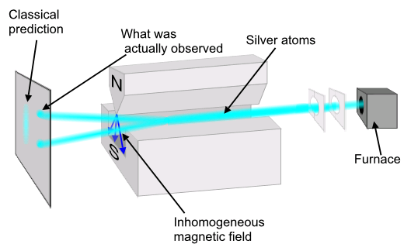
But…Measurement Limits You
Measurement
|0>
a|0> + b|1>
|1>
After measurement, quantum state collapses, information is lost!
Image adapted from: http://en.wikipedia.org/wiki/Stern-Gerlach_experiment
Notes:
300 qubits = 1 bit per atom in the universe

Slide 11
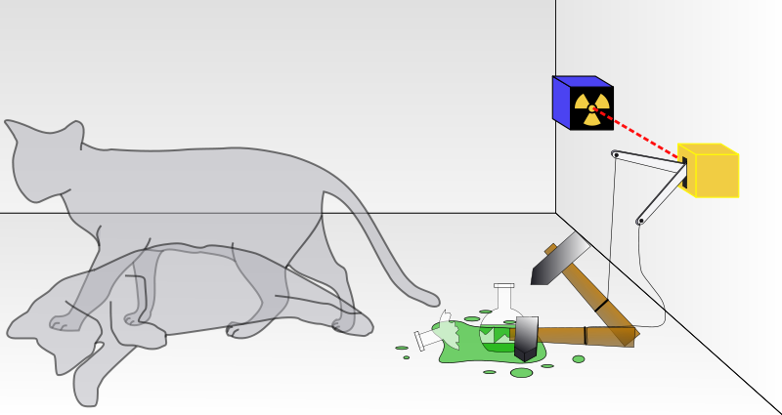
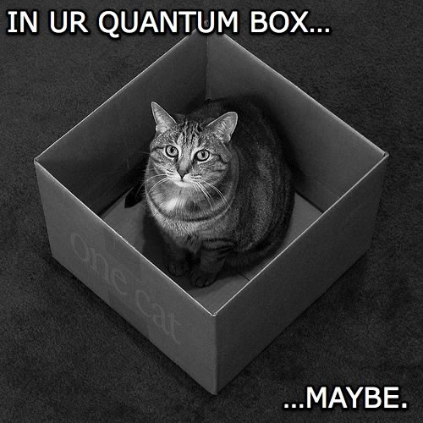
Paradox: Schrödinger’s Cat
Schrödinger’s Cat
Cat would be in a ‘superposition’ of alive and dead at the same time!
Image from: http://en.wikipedia.org/wiki/Schrödinger’s_cat

Slide 12
How Can You Benefit?
If measurement changes the answer, how can you fully utilize the 2^{N} states?
The key: use ‘hidden’ information with a clever algorithm
Still, in some cases, qubits still pay off!

Slide 13
Example: f(x)={0,1} for x = 0 or 1
Consider f(x)
Input: either 0 or 1
Output: either 0 or 1
Classically, you need at least two evaluations to determine if f(0) = f(1)
Using quantum gates, you need only one!

Slide 14
Deutsch Algorithm
ˆ
z = |0 >
Start with states along +x and -x:
[|0> + |1>][|0> - |1>]
Perform y xor f(x)
[|0> + |1>] [(|0> xor |f(x)>) - (|1> xor |f(x)>)]
(-1)^{f(x)}[|0> + |1>][|0> - |1>]
For f(0) = f(1): ±[|0> + |1>][|0> - |1>]
For f(0) ≠ f(1): ±[|0> - |1>][|0> - |1>]
ˆ
y
x
ˆ = |0> + |1>
ˆ
-z = |1 >
XOR | 0 | 1
0 | 0 | 1
1 | 1 | 0
f(0)=f(1): ±[|0> + |1>]
f(0)≠f(1): ±[|0> - |1>]
[|0> + |1>]
x x
y y xor f(x)
[|0> - |1>]
[|0> - |1>]
Measure

Slide 15
So What Have We Learned?
We determined a global property of the system faster than is possible classically
We can learn if f(0)=f(1) with one function evaluation
We can’t learn their value though! (One calculation gives only one bit of information)
Only a multiplicative factor speedup, but example is illustrative

Slide 16
Outline
What are quantum computers?
Classical vs. quantum bits
Problems suited to quantum computation
How to realize a quantum computer

Slide 17
RSA encryption
Recall: 100,000 computers in parallel operating at 3 GHz, RSA factoring would take longer than the age of the universe
Quantum computation allows a speedup from exponential to polynomial time!
A single 1 MHz quantum computer could do it in about 1 minute
Shor’s Algorithm
L. M. K. Vandersypen et al., Nature 414, 883 (2001).

Slide 18
Factorization Accomplishments
2001: 15=5x3
2012:
21=7x3 (iterative method)
143=13x11 (adiabatic quantum computer)
But don’t worry, quantum mechanics can be used for secure encryption as well!
L. M. K. Vandersypen et al., Nature 414, 883 (2001).
E. Martin-Lopez et al., Nat. Photonics. 6, 773 (2012).
N. Xu et al., Phys. Rev. Lett. 108, 130501 (2012).

Slide 19
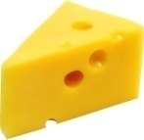
Classical search
Searching an unsorted list classically: no better way than guess and check (order N)

Slide 20
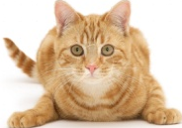
Quantum search: Grover’s Algorithm

Slide 21
Quantum search: Grover’s Algorithm

Slide 22
Quantum search: Grover’s Algorithm
Quantum search:
order N^{1/2}

Slide 23
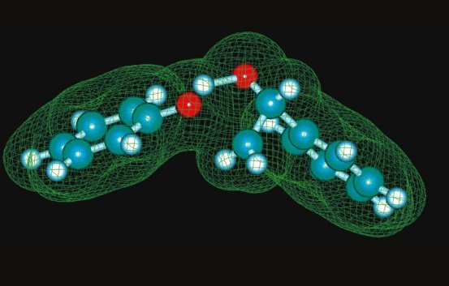
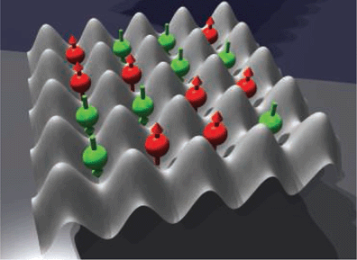
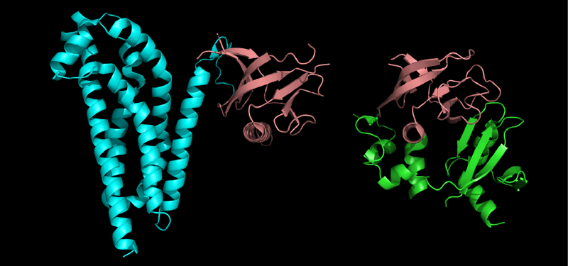
Other Potential Applications
Traveling salesman problem
Quantum Simulation
Protein conformation, or other problems with many variables (weather, stock market)
Images from:
http://www.ornl.gov/info/ornlreview/v37_2_04/article08.shtml
L. Fallani, M. Inguscio, Science, 322, 1480 (2008).
http://en.wikipedia.org/wiki/Protein_structure

Slide 24
Outline
What are quantum computers?
Classical vs. quantum bits
Problems suited to quantum computation
How to realize a quantum computer

Slide 25
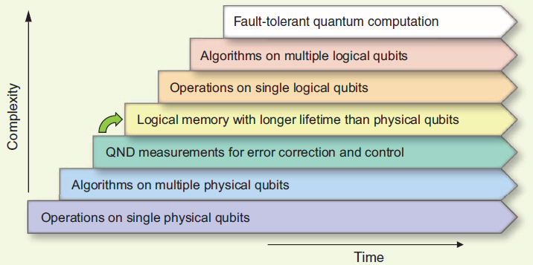
Steps to Build a Quantum Computer
Roadmap toward realizing a quantum computer
M. H. Devoret and R. J. Schoelkopf, Science, 339, 1169 (2013).

Slide 26
Classical Error Correction
Simply make three identical bits, and use majority rules
Perform
Operation
Majority vote wins

Slide 27
What about errors?
No-cloning theorem: in general, it’s impossible to copy a qubit
Measurement collapses a quantum state
How do you even tell if an error has occurred?
“Analog”-like system: continuous errors are possible
a|0> + b|1>
a|0> + b|1>
a|0> + b|1>

Slide 28
Quantum Error Correction is Possible
Errors can be found without performing a quantum measurement
Error rate threshold for fault-tolerant quantum computation: <10⁻⁴ to 10⁻⁶
Many ancillary qubits likely necessary for each logical qubit, but it can be done!

Slide 29
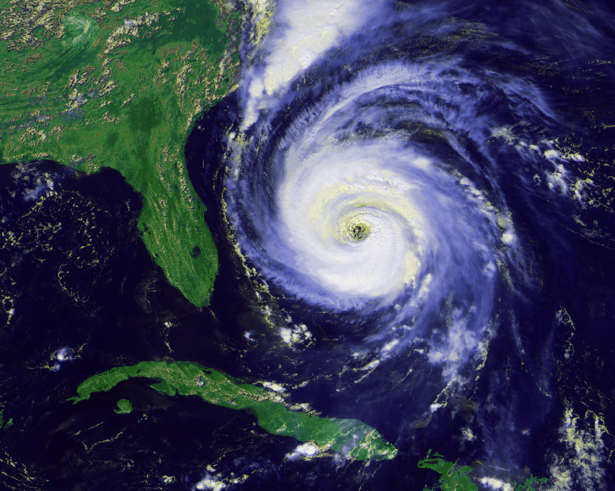
Qubit Control vs. Isolation
Fundamental dichotomy:
Any interaction with environment is bad: it ‘decoheres’ qubits (acts as a measurement)
Yet we want full control over the qubit

Slide 30
Proposed QC Schemes
Strong control over qubits
Trapped ions/atoms
Superconducting circuits
Spins in various materials
Isolation from decoherence
Topologically protected states
Quantum annealing (its own separate topic)

Slide 31
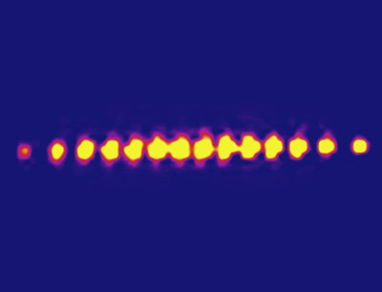
Ion Traps
Electrostatic traps hold ions in place (in vacuum)
Motion of ions serves to couple qubits
Technology developed first, and still “furthest along”: 14 qubits (2011)
T. Monz et al., Phys. Rev. Lett. 106, 130506 (2011).; L. Fallani, M. Inguscio, Science, 322, 1480 (2008).

Slide 32
Superconducting and Spin Qubits
http://web.physics.ucsb.edu/~martinisgroup/
Image courtesy of M.D. Shulman
Superconducting qubits: aluminum circuits
Amount of charge, Direction of superconducting current, Phase of current across a junction
Spins
Defect centers in diamond, silicon
Artificial atoms

Slide 33
Topologically Quantum Computation
First move in Y, then in X
vs.
Top
Top
Front
Front
First move in X, then in Y:
Side
Side
You get the same result either way
For most things: order of operations doesn’t matter

Slide 34
Topologically Protected States
“Non-abelian” states: order of operations matters
Insensitive to noise from environment
First rotate around Y, then around X
First rotate around X, then around Y: different result!
Top
Front
Side
Side
Top
y
Top
Side
x

Slide 35
Summary of Qubit Approaches
Qubit type | Advantages | Weaknesses
Ion/atom Trap | -Extremely good quantum state control -Little interaction with environment -All ions are identical | -Difficult to scale up the number of qubits
Superconducting | -Compatible with current lithography procedures -Electrical control | -Each qubit is slightly different due to fabrication imperfections
Spins | Depending on the system: -Potentially long coherence times -Optical and/or electrical control possible -Room temperature operation | -Each qubit may be slightly different -Difficult to isolate from the environment
Topological | -Insensitivity to noise in the environment | -Forming topologically protected states is difficult -No demonstrated qubits yet

Slide 36
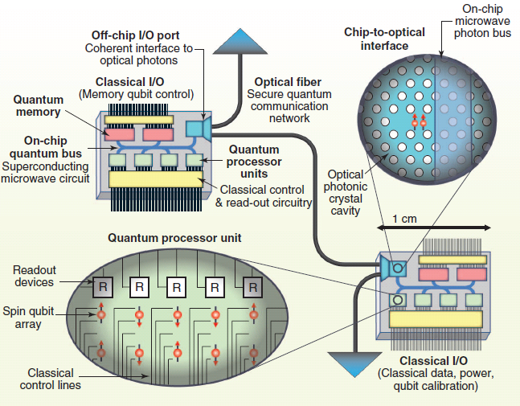
Putting it all Together
Likely final solution: combined technology that takes advantage of the strengths of each approach
For example:
-Trapped ions for long-lived qubit states
-Spin qubits for readout
-Superconducting circuitry for quantum buses
D.D. Awschalom et al., Science, 339, 1174 (2013).

Slide 37
Quantum Annealing
Many problems can be mapped onto the question: What is the ground state?
Initialize a known problem in its ground state.
Transform into a problem of interest. Go slowly so that you stay in the ground state.
Nature has solved the problem for you!
M. W. Johnson et al., Nature 473, 149 (2011).

Slide 38
Quantum Annealing: D-wave
D-wave makes and sells quantum annealers (superconducting qubit base)
Lockheed Martin: bought a 128-qubit model
Google and NASA: bought one with 512 qubits to work on artificial intelligence
But: debate in community whether these are true quantum computers, and if they’re better than classical algorithms
See: http://www.dwavesys.com/en/dw_homepage.html http://scottaaronson.com/blog

Slide 39
Conclusions and Outlook
Quantum computing is very much in its infancy
Already, several ideas for applications
Nobody can predict what might come out; who could have imagined the internet in 1950?

