Slide 1
From High-level Haskell to Efficient Low-level Code
Geoffrey Mainland
Microsoft Research Cambridge
Big Techday 6
June 14, 2013

Slide 2
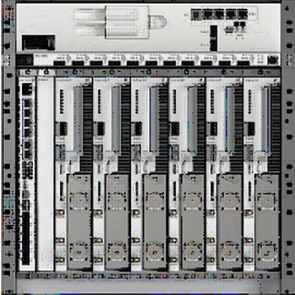
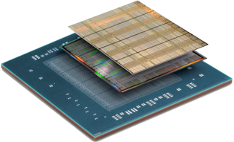
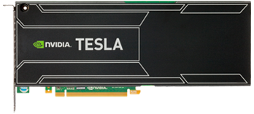
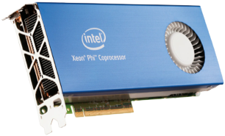
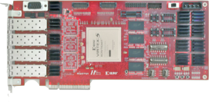
USRP N200
Virtex-7 FPGA
RBS 6202
Tesla K-20
Intel Xeon Phi
NetFPGA 10G
2

Slide 3
USRP N200
Programming These Devices is an Extreme Sport!
Virtex-7 FPGA
RBS 6202
Many PhD careers spent programming these devices—and not just in computer science.
Much duplicated effort.
Lots of low-level code.
And yet vitally important.
Tesla K-20
Intel Xeon Phi
NetFPGA 10G
3

Slide 4
High-level Languages
USRP N200
Virtex-7 FPGA
RBS 6202
Tesla K-20
Intel Xeon Phi
NetFPGA 10G

Slide 5
This talk
Generalized Stream Fusion: Turning high-level numerical Haskell into efficient low-level loops.
Nikola: Compiling high-level Haskell into efficient GPU code.

Slide 6
Abstraction…
but at what price?

Slide 7
Abstraction Without Cost
double norm2_bad(VectorXd const& v)
{
return v.dot(v);
}
double eigen_rbf_abs_bad(double nu, VectorXd const& x,
VectorXd const& y)
{
return exp(-nu*norm2_bad(x-y));
}

Slide 8
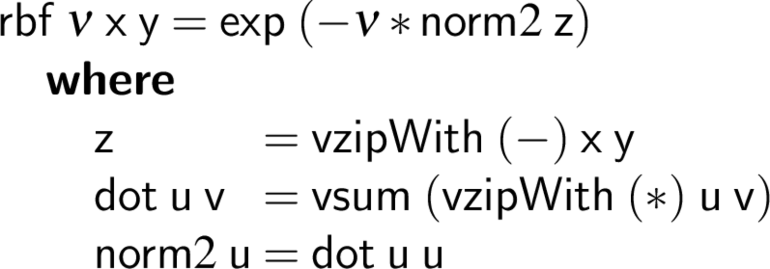
Abstraction Without Cost

Slide 9
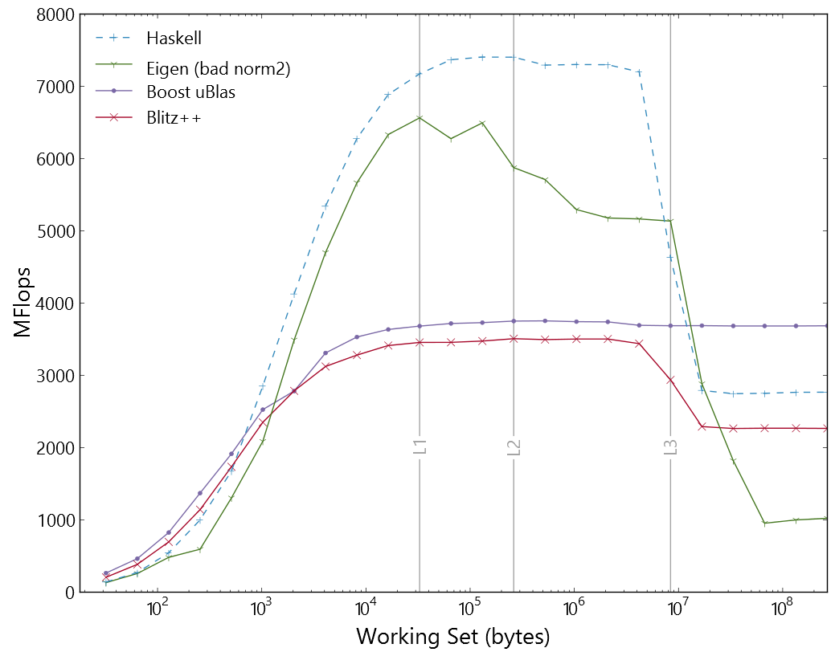
Abstraction Without Cost
Haskell
Eigen
Boost uBlas
Blitz++

Slide 10
Abstraction Without Cost
“To summarize, the implementation of functions taking non-writable (const referenced) objects is not a big issue and does not lead to problematic situations in terms of compiling and running your program. However, a naive implementation is likely to introduce unnecessary temporary objects in your code. In order to avoid evaluating parameters into temporaries, pass them as (const) references to MatrixBase or ArrayBase (so templatize your function).”
—Eigen Documentation, “Advanced Topics”

Slide 11
Abstraction Without Cost
double norm2_bad(VectorXd const& v)
{
return v.dot(v);
}
double eigen_rbf_abs_bad(double nu, VectorXd const& x,
VectorXd const& y)
{
return exp(-nu*norm2_bad(x-y));
}

Slide 12
Abstraction Without Cost
template <typename Derived>
typename Derived::Scalar
norm2(const MatrixBase<Derived>& v)
{
return v.dot(v);
}
double eigen_rbf(double nu, VectorXd const& x,
VectorXd const& y)
{
return exp(-nu*norm2(x-y));
}

Slide 13
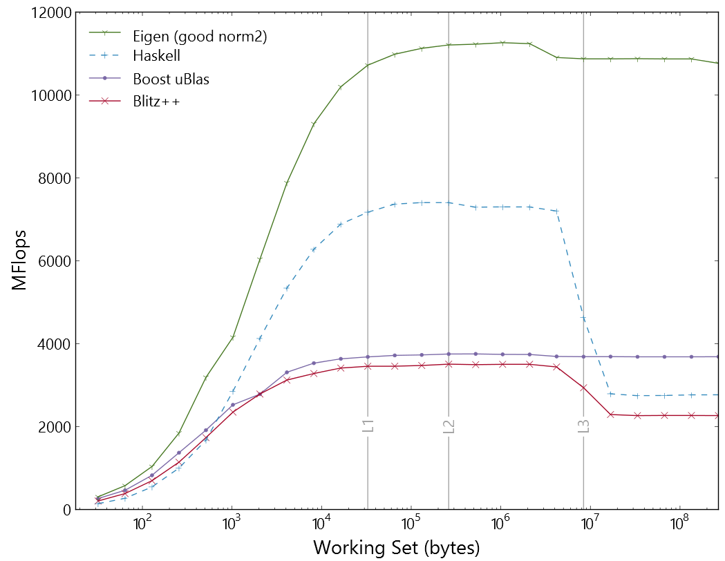
Abstraction Without Cost
Eigen
Haskell
Boost uBlas
Blitz++

Slide 14
Different levels of abstraction

Slide 15
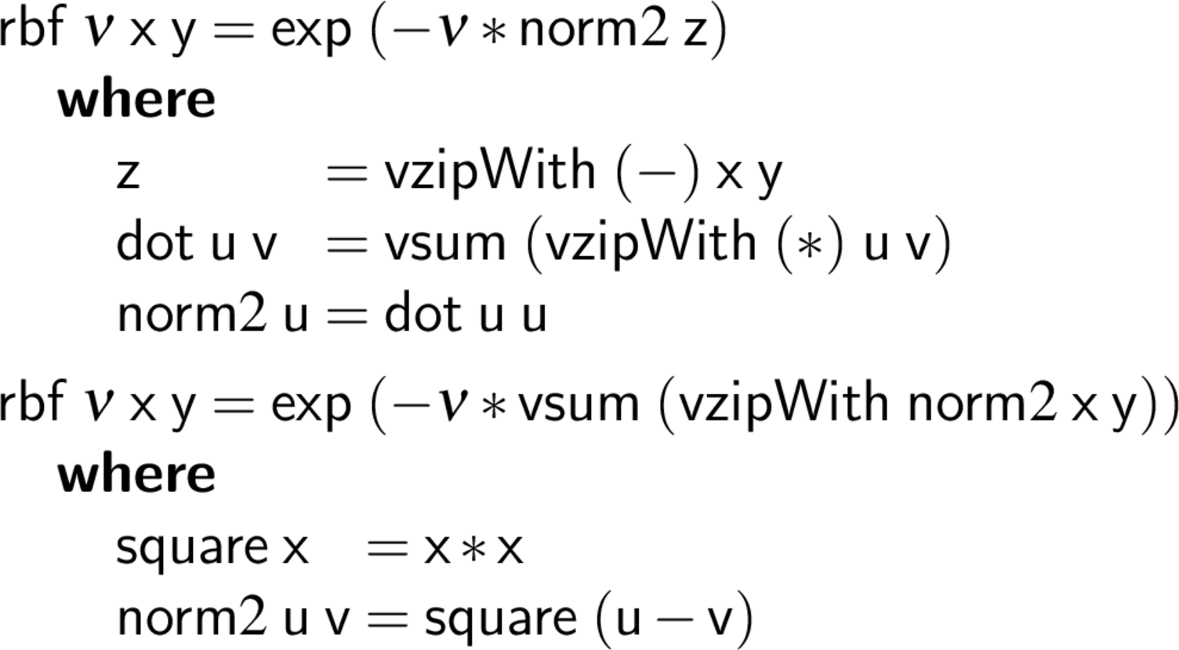
Different levels of abstraction

Slide 16
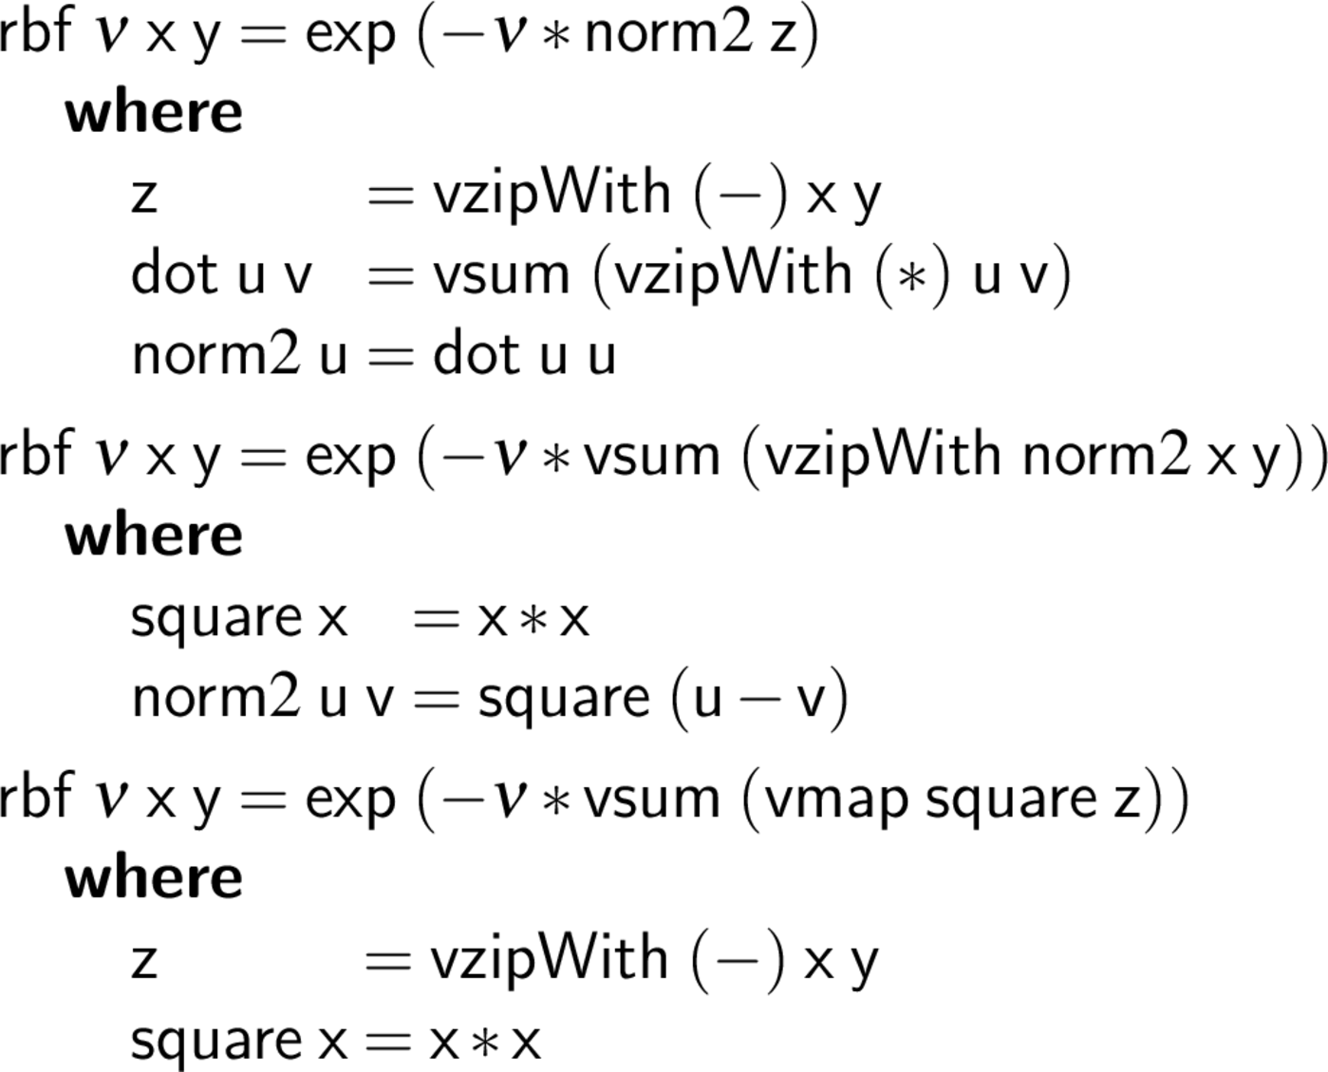
Different levels of abstraction

Slide 17
Haskell Inner Loop
.LBB4_12:
prefetcht0 1600(%rcx,%rdi)
vmovupd 64(%rcx,%rdi), %xmm1
prefetcht0 1600(%rsi,%rdi)
vmovupd 80(%rcx,%rdi), %xmm2
vmulpd 80(%rsi,%rdi), %xmm2, %xmm2
vmulpd 64(%rsi,%rdi), %xmm1, %xmm1
vaddpd %xmm1, %xmm0, %xmm0
vaddpd %xmm2, %xmm0, %xmm0
vmovupd 96(%rcx,%rdi), %xmm2
vmovupd 96(%rsi,%rdi), %xmm3
vmovupd 112(%rcx,%rdi), %xmm1
vmulpd 112(%rsi,%rdi), %xmm1, %xmm1
vmulpd %xmm2, %xmm3, %xmm2
addq $64, %rdi
leaq 8(%rax), %rdx
addq $16, %rax
vaddpd %xmm2, %xmm0, %xmm0
cmpq %rbx, %rax
vaddpd %xmm1, %xmm0, %xmm0
movq %rdx, %rax
jle .LBB4_12

Slide 18
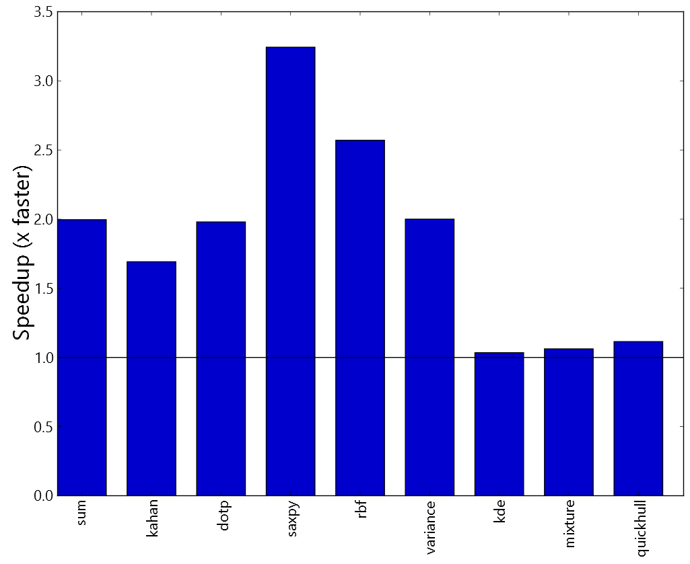
Generalized Stream Fusion

Slide 19
Generalized Stream Fusion
Goal: make efficient use of bulk memory operations and SSE/AVX instructions from high-level, declarative Haskell.
Exploiting Vector Instructions with Generalized Stream Fusion. Geoffrey Mainland, Roman Leshchinskiy, and Simon Peyton Jones. ICFP ’13, to appear.
Stream Fusion: From Lists to Streams to Nothing at All. Duncan Coutts, Roman Leshchinskiy, and Don Stewart. ICFP ‘07.

Slide 20
Stream Fusion

Slide 21
Stream Fusion

Slide 22
Map, recursively

Slide 23
Avoiding recursion with streams

Slide 24
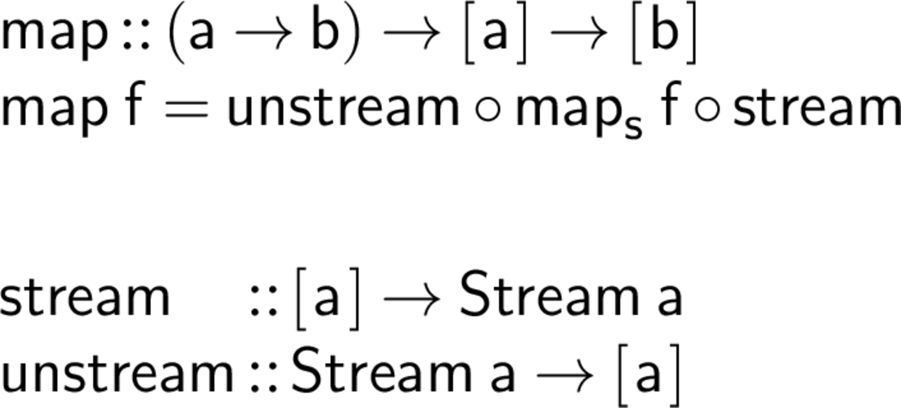
Map, non-recursively

Slide 25
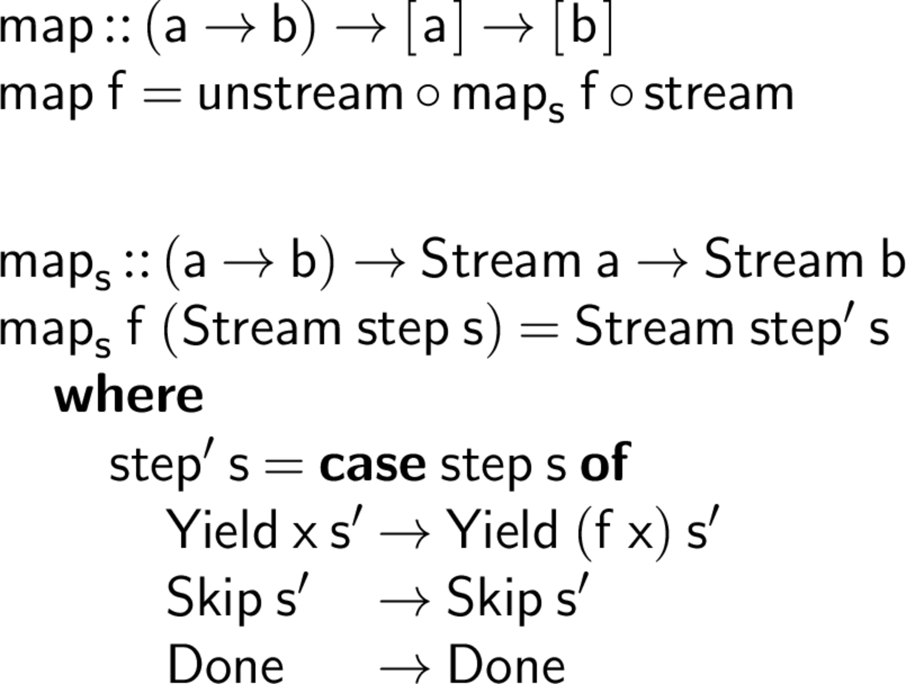
Map, non-recursively

Slide 26
Fusion

Slide 27
Fusion

Slide 28
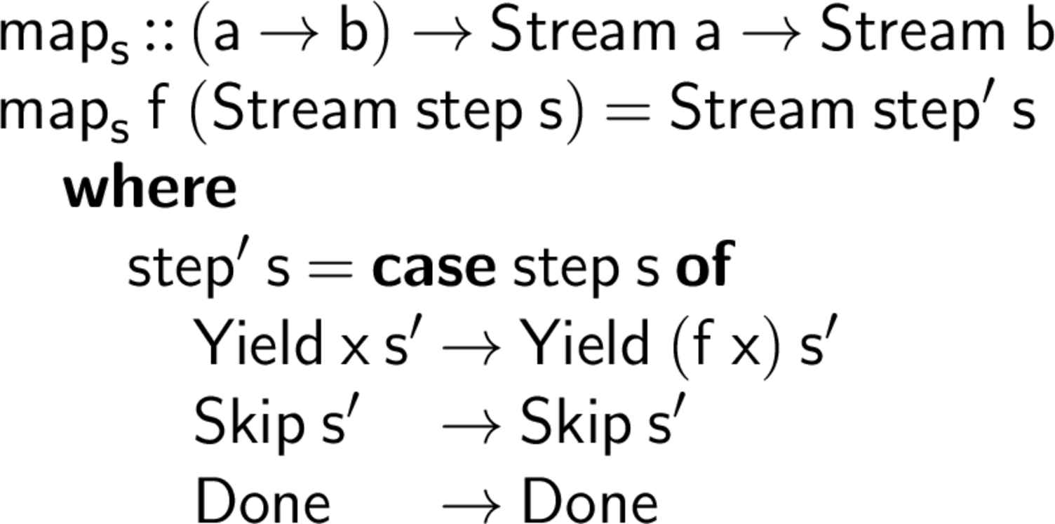
Fusion

Slide 29
Stream Fusion
Useful for much more than map!
Key idea is to move all recursion into unstream and then let the inliner loose.
Generalized stream fusion allows multiple, simultaneous, representations of streams.
Must be careful to ensure the compiler can optimize away all but one representation!

Slide 30
Nikola: Haskell on GPUs
Compile a subset of Haskell to GPU binary code.
Automatically manages marshalling data between the CPU and GPU.
Programmer has an “escape hatch” to CUDA when necessary.
Does not require compiler modifications or run time code generation.
Tesla K-20
Nikola: Embedding Compiled GPU Functions in Haskell. Geoffrey Mainland and Greg Morrisett. Haskell '10.

Slide 31
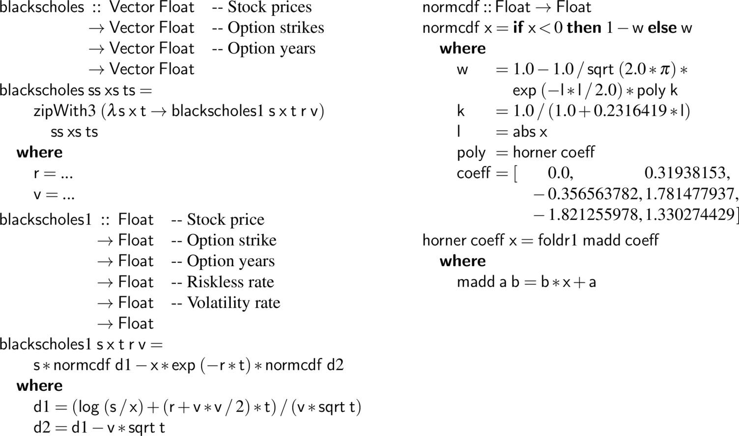
Black-Scholes: Haskell

Slide 32
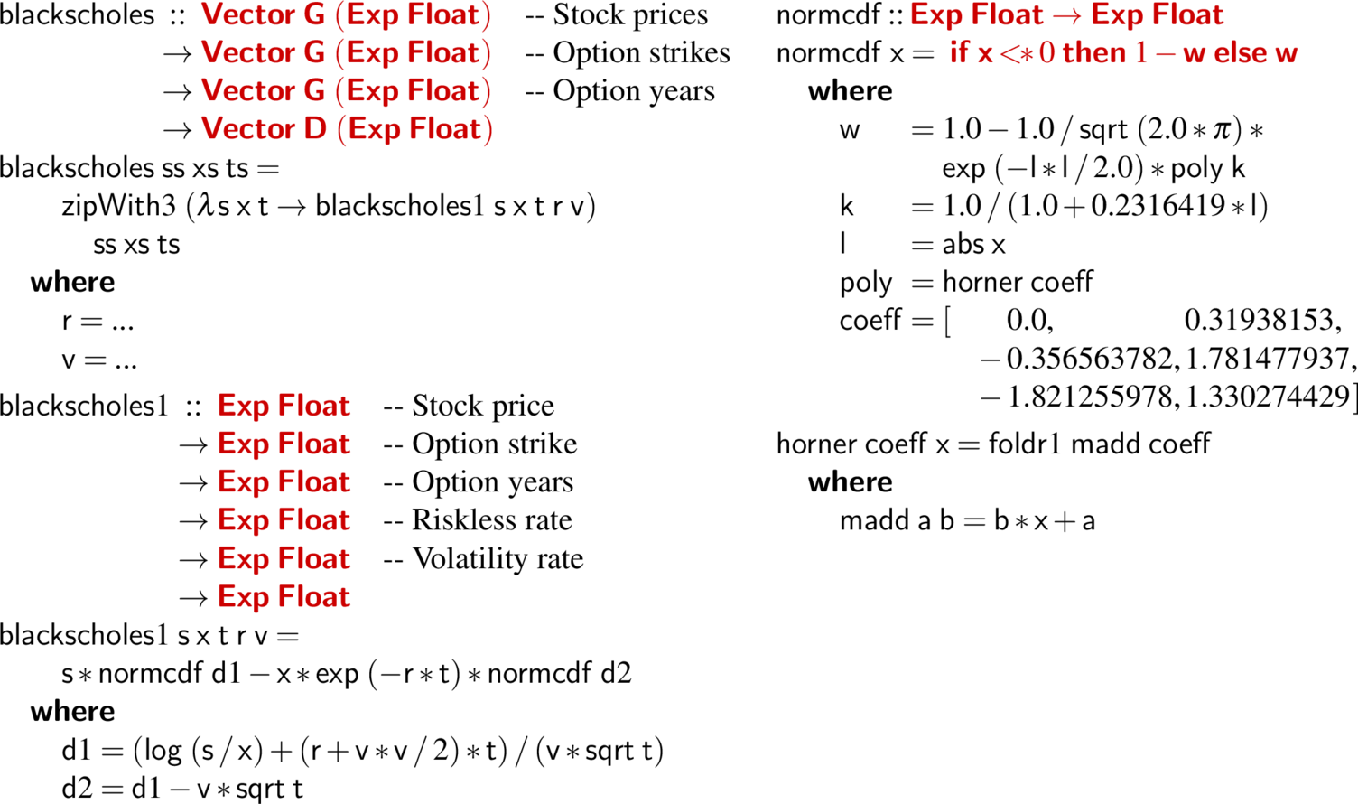
Black-Scholes: Nikola

Slide 33
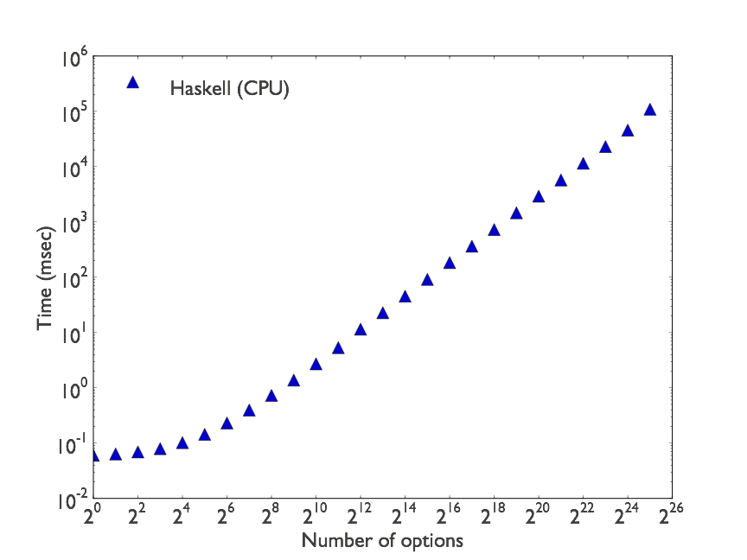
Black-Scholes Performance

Slide 34
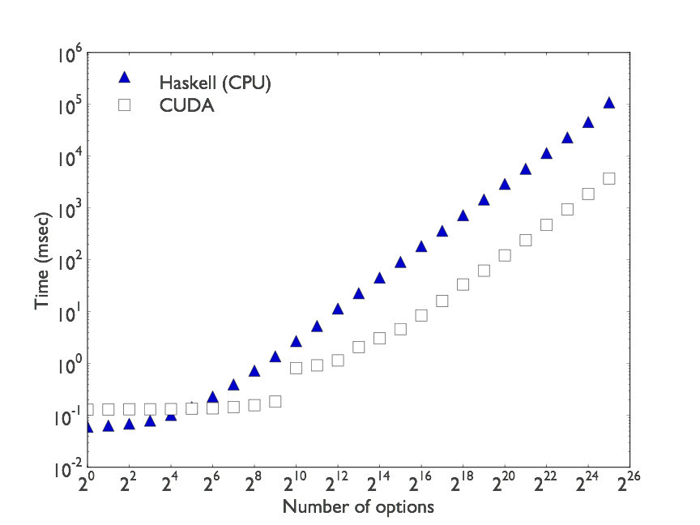
Black-Scholes Performance

Slide 35
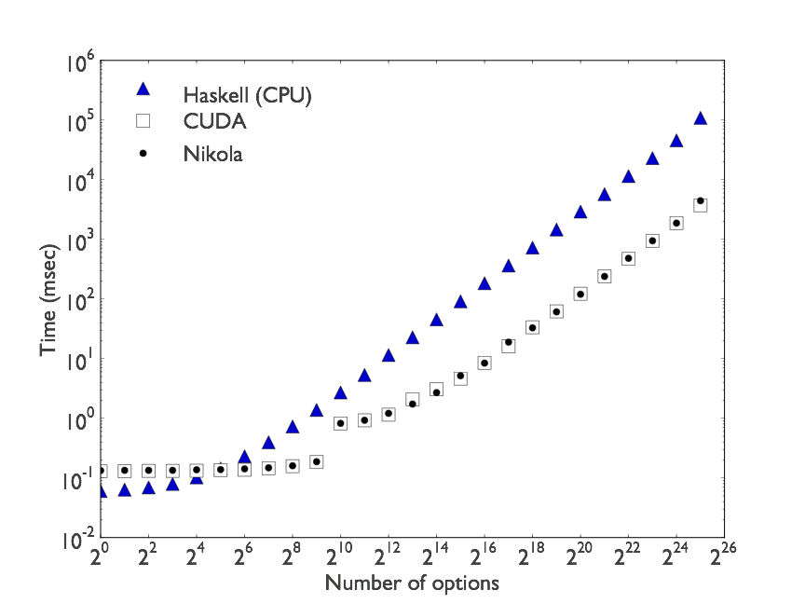
Black-Scholes Performance

Slide 36
Sobel Edge Detection in Nikola

Slide 37
From High-level Haskell to Efficient Low-level Code
We can make high-level abstractions very cheap.
High-level languages can be compiled to efficient low-level code.
Even on very different architectures!
http://www.haskell.org/
http://www.eecs.harvard.edu/~mainland

