Slide 1
Tap into the Power of Slaves with Jenkins
Kohsuke Kawaguchi

Slide 2
Have You Met Jenkins?
http://jenkins-ci.org/
Notes:
Java
OSS

Slide 3
x 64,000
Notes:
Most adopted
8 years old

Slide 5
x 700

Slide 6
32%
Notes:
More than 30% uses no slaves at all or just one

Slide 7
18%
Notes:
50+ slaves. There’s a divide here.

Slide 9
Isolation

Slide 10
Workload

Slide 11
Diversity
© Kurt Löwenstein Educational Center International Team
http://commons.wikimedia.org/wiki/File:Discrimination-Diversity-03.jpg
Creative Commons Attribution 2.0 Generic

Slide 12
Demo
Really, We Made It Easy!

Slide 13
Distributed builds with Jenkins
Master
Serves HTTP requests
Stores all important info
Slaves
280KB single jar
Assumed to be unreliable
Scale to at least 100
Master
slave1
slave2
slave3
slave4
slave5
slave6
slave7
slave8

Slide 14
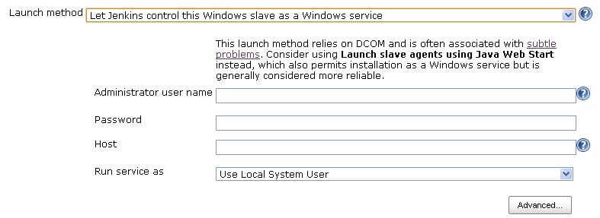
Lots More Ways to Deploy Slaves
Via DCOM

Slide 15
Lots More Way To Deploy Slaves
Good old shell scripting
$ java -jar slave.jar -jnlpUrl URL

Slide 16
How Flexible Does It Get?
Slave agent is a little Java program
Runs locally on the machine that it controls
Access files, fork processes, etc., on behalf of master
Communication with master
Just needs a bi-di byte stream
No shared file system, no network topology constraints, etc

Slide 17
Static Virtual Machines As Build Slaves
Allocate lots of identical VMs
Better consistency, lower overhead
Curve up 1 big machine to small VMs
Throw away > maintain
Notes:
Another common mode of deployment is…
Even if it’s static…

Slide 18
Labels
Refer to slaves but not by name
Name: alpha
Label: windows 32bit
Name: bravo
Label: linux 32bit
Name: charlie
Label: linux 64bit

Slide 19
Labels
Name: alpha
Label: windows 32bit
Name: bravo
Label: linux 32bit
This job needs to run on “linux”
Name: charlie
Label: linux 64bit

Slide 20
Labels
Name: alpha
Label: windows 32bit
Name: bravo
Label: linux 32bit
This job needs to run on “linux && 32bit”
Name: charlie
Label: linux 64bit

Slide 21
More Label Benefits
Labels can be anything
Geographic locations
Availability of proprietary software installed
Better resource utilization
Jenkins have maximum freedom
Resilient to node addition/removal
Treat servers like livestocks, not like pets

Slide 22
Labels
↓ Elastic Slaves

Slide 23
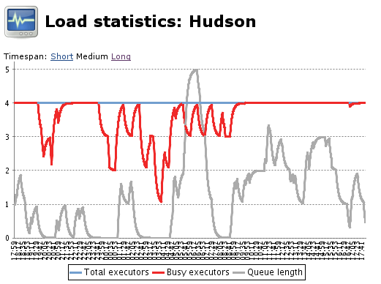
Tracking demand for specific label

Slide 24
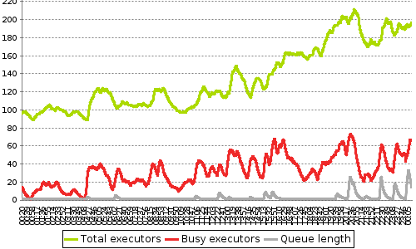
Then Adjust Capacity based on it

Slide 25
How?
EC2 Plugin
Longest history, most popular
JClouds plugin
For OpenStack & CloudStack users, mainly
Unfortunate name, if you ask me
Common to both
Multiple image types

Slide 26
Interesting Use Cases Worth Noting
Single-use slaves (JClouds)
Used once & destroyed
Static but utility-priced slaves (EC2)
Jenkins stops idle slaves to reduce $$$
Great for infrequent use
Coming soon: spot instances (EC2)

Slide 27
CloudBees DEV@cloud
Completely elastic slaves
Keeps your warm workspace
Per-minute pricing, not per-hour

Slide 28
Now that we have more slaves…
#1: parallel test execution

Slide 29
Running Tests in Parallel
Why?

Slide 30
Pre-requisites
Build script that supports test exclusion file

Slide 31
How It Works
Test Group #1
Test Group #2
Test Group #3

Slide 32
How It Works
foo #10
Test Group #1
foo #11
Test Group #2
foo #12
Test Goup #3

Slide 33
Demo

Slide 34
For Maven
Trick
Turn a build into a Maven repository
Maven profiles for controlling what to run when
Test Group #1
Build
Parallel Test
Test Group #2
Test Group #3

Slide 35
Demo

Slide 36
Now that we have more slaves…
#2: activities than span multiple computers

Slide 37
Build Flow Plugin
Groovy DSL for coordinating job executions
High-level primitives
Ability to define abstractions
b = build(“acme-build”)
guard {
parallel (
{ build(“acme-test1”, param1:b.number) },
{ build(“acme-test2”, param1:b.number) }
)
} rescue {
build(“acme-teardown”)
}

Slide 38
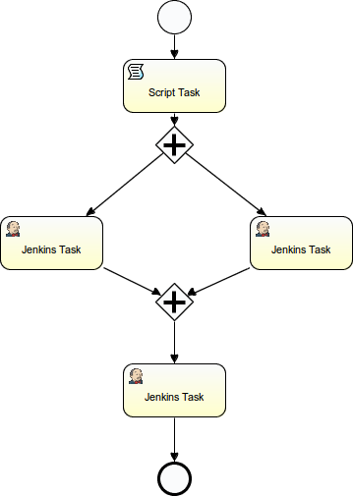
Jenkow Plugin
Embed BPMN workflow engine in Jenkins
Timeout, fork, join, …
Workflow is version controlled in Git
Push to Jenkins to load them up

Slide 39
Lease and SSH access
Remote terminal access plugin
Lease Jenkins executors for interactive SSH access

Slide 40
Demo

Slide 41
Lease and SSH access: characteristics
Easy coordination between nodes
Jenkins scheduling aware
No dependency to individual slaves

Slide 42
Now that we have more slaves…
#3: validated merge

Slide 43
Did this ever happen to you?

Slide 44
Commit
↓ Push
↓
Test

Slide 45
Commit
↓ Test
↓
Push

Slide 46
More concretely
You push to Jenkins
Jenkins merges it with upstream
Jenkins tests it
If good, Jenkins pushes it upstream
upstream
repo
gate
repo

Slide 47
Demo

Slide 48
Conclusions
Tame more slaves
Lots of interesting things you can do

Slide 49
Now that we have more slaves…
#4: matrix projects

Slide 50
Motivation
You often do the same thing with slight variations
Compile C++ code for different platforms
Test with different browsers
Or more generally, think of it as
for (x in [a,b,c]) {
for (y in [d,e,f]) {
doSomethingWith(x,y,z,..);
}
}

Slide 51
Model
Define axes
One axis ≈ one for loop
Choose from pre-defined types of Axis
Slave axis: pick slaves by their names or their labels
e.g., linux, solaris, and windows
Generic axis: arbitrary values exposed as environment variables

Slide 52
Matrix Project Gimmicks
Filtering
Otherwise combinations increase exponentially
Not all combinations make sense
Use boolean expression to trim down the size
Or tell Jenkins to cut the workload to N%
Jenkins will thin out the combinations by itself
(label==“windows”).implies(browser==“iexplore”) && (label==“mac”).implies(browser==“safari”)

Slide 53
Demo

